Slide 1
Rule based triple extraction
Workshop
Dongsheng

Slide 2
Content
Task description
Method
Trie tree
Trigers
Time complexity

Slide 3
Task description
CAUSE EFFECT
Target:
ribavirin inhibit SARS coronavirus
In this report, ribavirin was shown to inhibit SARS coronavirus replication in five different cell types of animal or human origin at therapeutically achievable concentrations.

Slide 4
Neural networks
Neural networks
Entity detection or mention detection
Relation extraction
Both of the requires annotations
Rule-based
Triger-based

Slide 5
Method
Two steps
Store the rules of sequential tags into a trie tree
Trigger a free text and search the trie tree to match

Slide 6
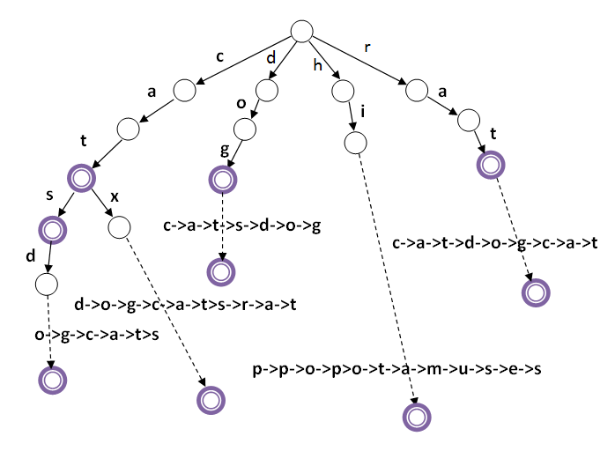
Brief introduction of trie tree
['nsubjpass', 'auxpass', 'ROOT', 'mark', CAUSE_LABEL, 'compound', 'compound','dobj']
Sentence
Ribavirin | Was | Shown | To | Inhibit | SARS | Coronavirus | Replication | In | …
NNP | VBD | VBN | TO | CAUSE_LABEL | NN | NN | NN | IN | …
nsubjpass | auxpass | ROOT | mark | CAUSE_LABEL | compound | compound | dobj | cc | …
Rule-pattern
or

Slide 7

Overall framework
Output
Trie tree search
CoreNLP
(tag sequence generator)
Semi-automatic
Annotation
Relation Trigger
PMC (PubMed)

Slide 8
Time complexity
Advantages of trie tree search
The recall can be low, but the accuracy is good
It is easy to annotate triples to improve the coverage
Time complexity
keyword trigger -> O(N+L)*K where N is the number of words, and L is the length of trigger keyword and K is number of relations
Trie tree search -> O(N^2) where N is number of words, usually we early stop the search either we found a rule or when it reaches the CAUSEL_LABEL

Slide 9
Conclusion
It is easier to generate rule patterns meanwhile annotation is not difficult
If we could accumulate certain amount of rules, it will improve recall while maintain high precision

Slide 10
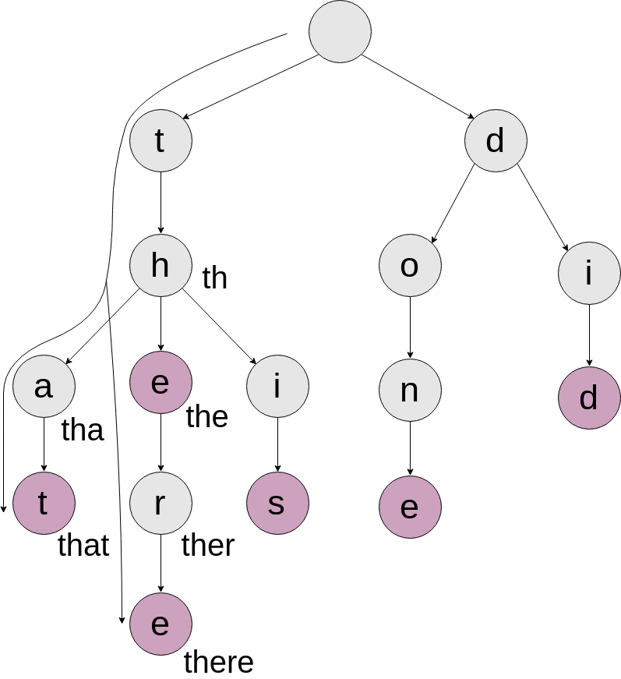
Other details
Start: greedy
End: Longest route

